Slide 1
New grouping results
Luca Terenzi

Slide 2
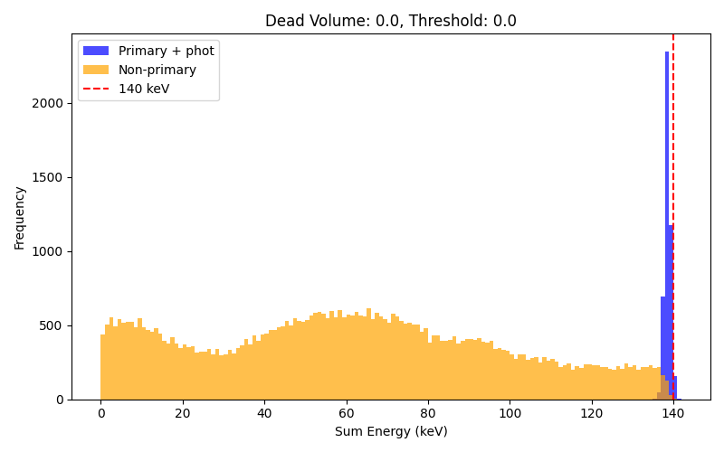
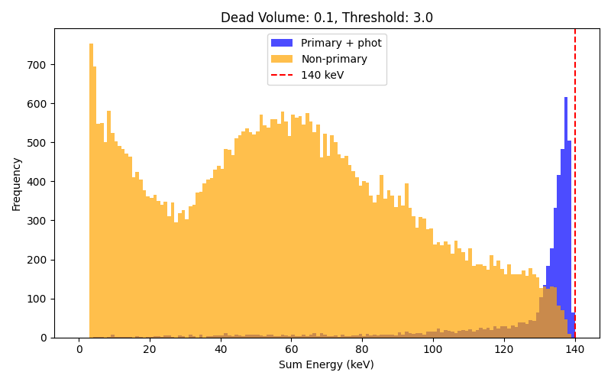
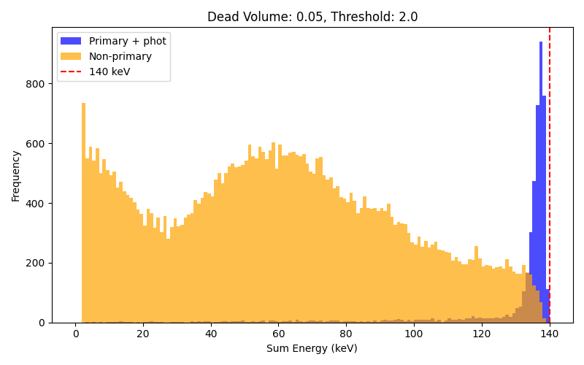
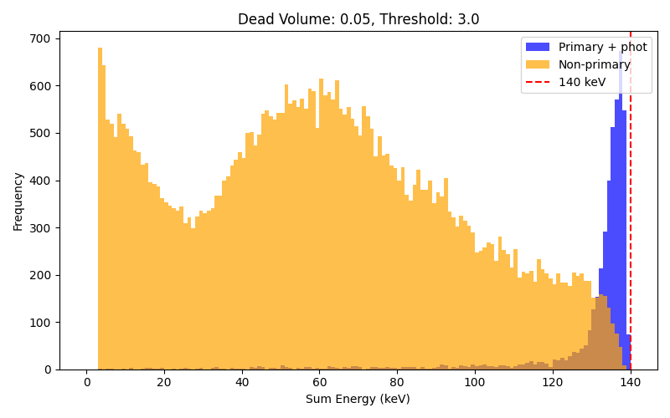
Dead volume 3.0, 20 cm diameter phantom

Slide 3
Dead volume 3.0, 20 cm diameter phantom
dead_volume | threshold | efficiency | total_efficiency | scatter_fraction | best_threshold | best_snr
0 | 0 | 0,93 | 0,066 | 0,069 | 137 | 63,8
0,05 | 0 | 0,93 | 0,055 | 0,070 | 137 | 58,2
0,1 | 0 | 0,93 | 0,046 | 0,067 | 137 | 53,7
0,15 | 0 | 0,93 | 0,039 | 0,068 | 137 | 49,3
0 | 1 | 0,89 | 0,065 | 0,108 | 135 | 62,0
0,05 | 1 | 0,89 | 0,055 | 0,108 | 135 | 57,2
0,1 | 1 | 0,89 | 0,047 | 0,111 | 135 | 52,6
0,15 | 1 | 0,89 | 0,039 | 0,115 | 135 | 48,0
0 | 2 | 0,85 | 0,062 | 0,153 | 133 | 59,3
0,05 | 2 | 0,84 | 0,052 | 0,155 | 133 | 54,2
0,1 | 2 | 0,85 | 0,046 | 0,152 | 133 | 51,1
0,15 | 2 | 0,85 | 0,039 | 0,154 | 133 | 46,9
0 | 3 | 0,79 | 0,062 | 0,212 | 130 | 57,2
0,05 | 3 | 0,79 | 0,053 | 0,214 | 130 | 52,9
0,1 | 3 | 0,78 | 0,046 | 0,217 | 130 | 49,0
0,15 | 3 | 0,78 | 0,039 | 0,224 | 130 | 44,8
0 | 4 | 0,78 | 0,058 | 0,221 | 129 | 54,8
0,05 | 4 | 0,78 | 0,050 | 0,223 | 129 | 51,0
0,1 | 4 | 0,77 | 0,044 | 0,226 | 129 | 47,4
0,15 | 4 | 0,77 | 0,037 | 0,225 | 129 | 43,8
0 | 5 | 0,68 | 0,061 | 0,318 | 124 | 52,7
0,05 | 5 | 0,68 | 0,053 | 0,322 | 124 | 49,0
0,1 | 5 | 0,68 | 0,047 | 0,322 | 124 | 46,0
0,15 | 5 | 0,67 | 0,040 | 0,330 | 124 | 42,1

Slide 4
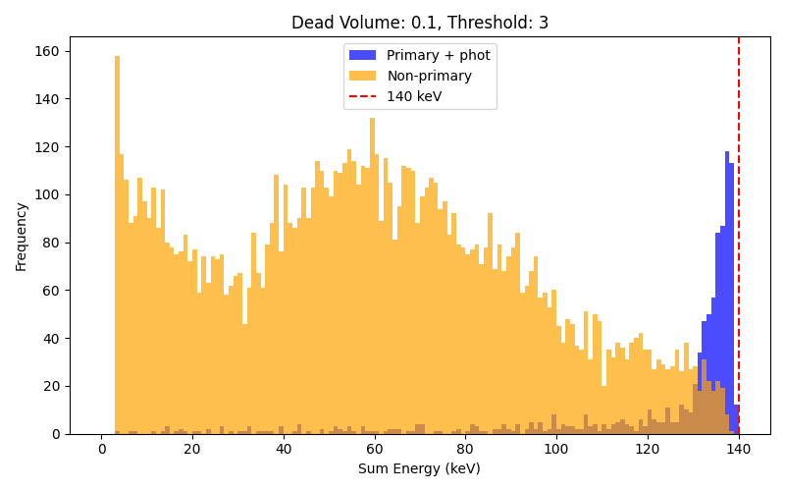
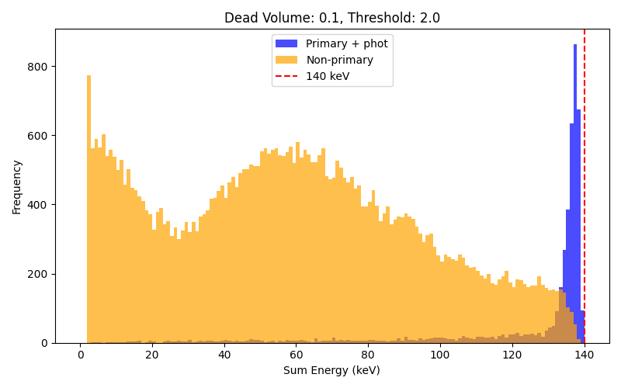

Same case (left), dead volume geometry simulated (right)
Less statistic ( 100 k events) due to increased computational cost and RAM usage

Slide 5
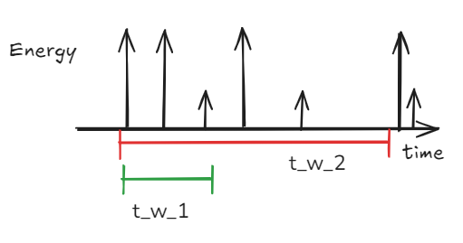
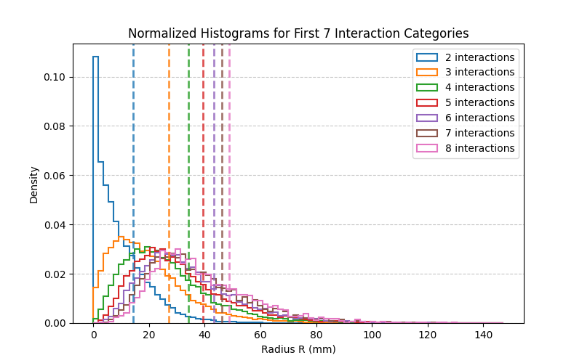
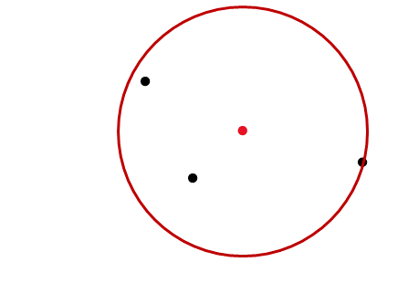
Grouping algorithm
Seeding interaction: We take the first ungrouped interaction and try to group it to all other interactions from the same event
Time window: we take a first time window based on the time uncertainty of the seeding interaction, and we take all interaction within it. Then a second time window, based on the worst possible time uncertainty and we take from that one all interactions that have an energy deposited smaller than the seeding interaction.
Grouping algorithm: start from seed → take closest point → compute radius of interaction volume → if below threshold remove last interaction and stop, otherwise continue.
NB: in this case the threshold was computed as the radius values for the 75th percentile
Radius

Slide 6
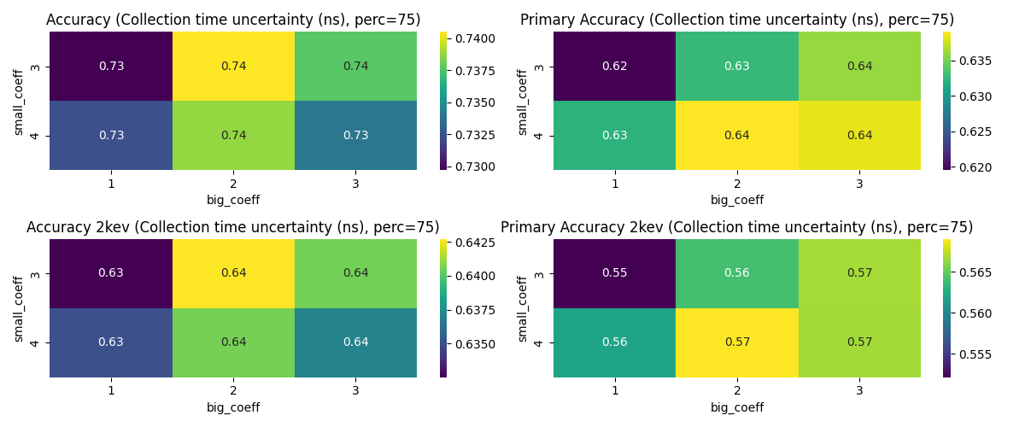
Grouping algorithm
Run 10 realizations on the same dataset, each time drawing a gaussian realization for noise on the energies and time uncertainty
5000 groups made in each realization
Accuracy (true positive) = correct groups / total number of events
False positive = incorrect groups / total number of events
140 kev, 60 ENC, 2 kev pixel threshold (applied to the interaction for simplicity)
Here I keep into account the knowledge of the true interaction chains before thresholding, meaning that events having one interaction lost due to threshold will not be able to ever be correctly grouped

Slide 7
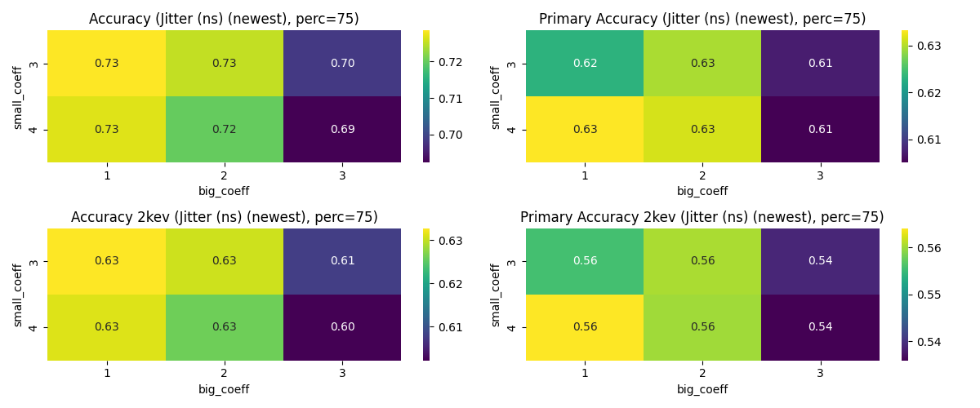
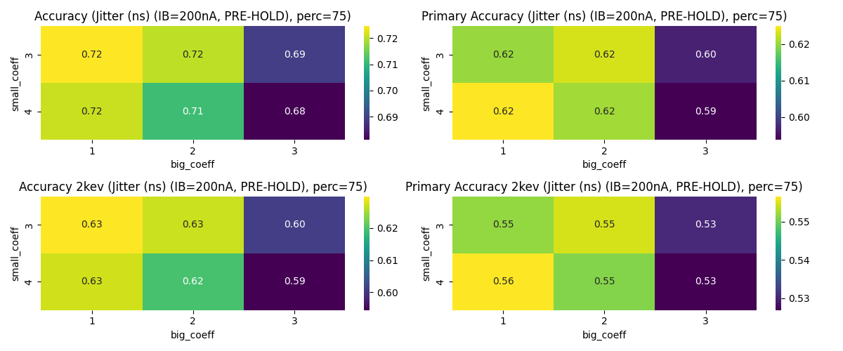
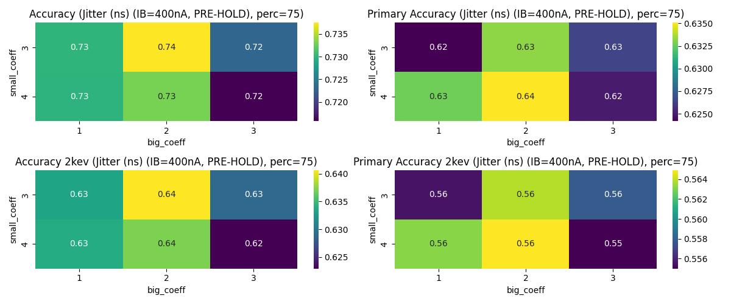
Grouping algorithm

Slide 8
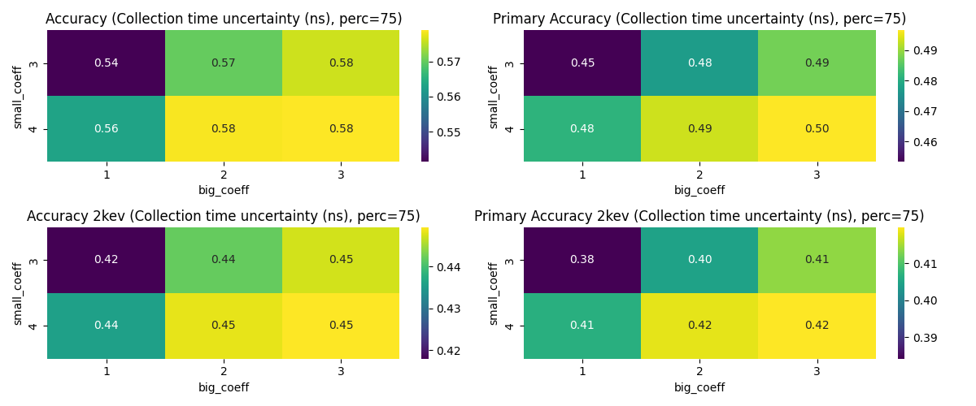
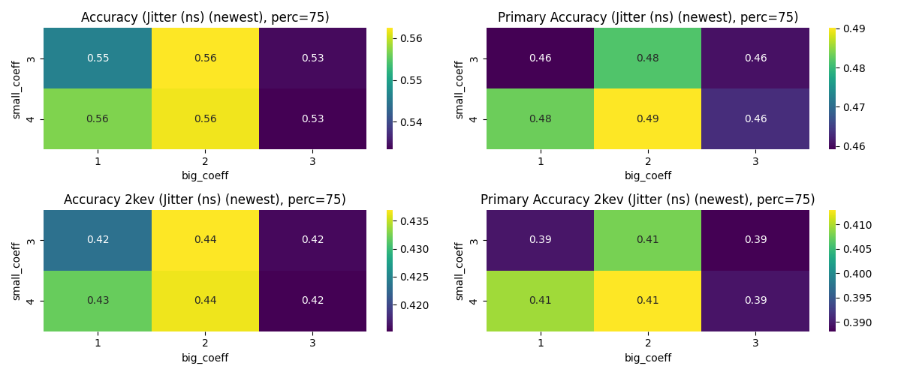
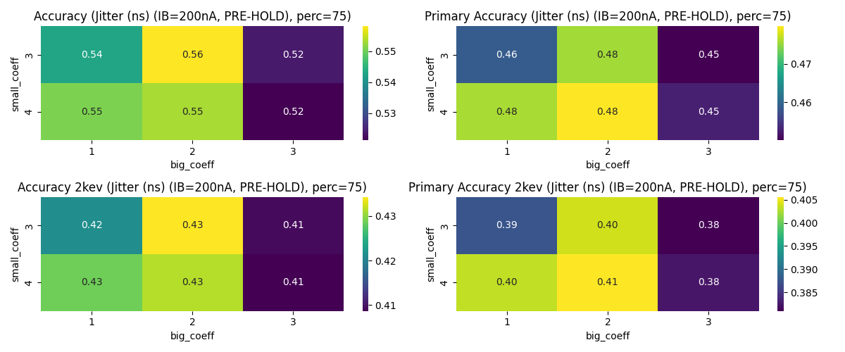
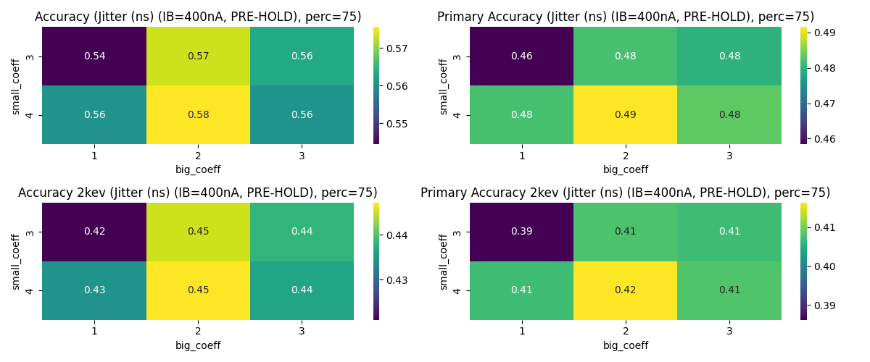
Grouping algorithm, 2 or more interactions

Slide 9
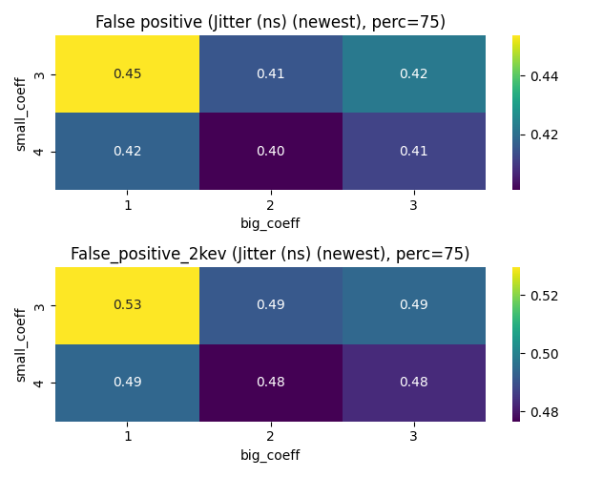
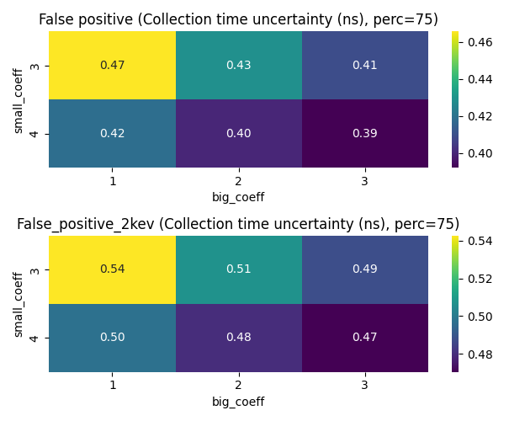
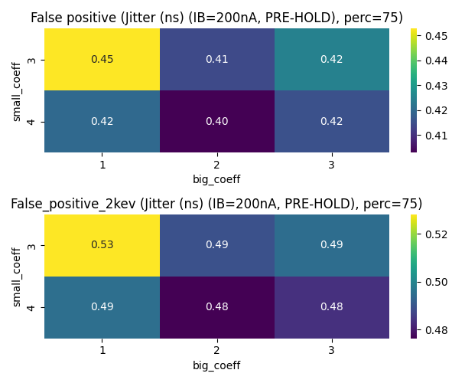
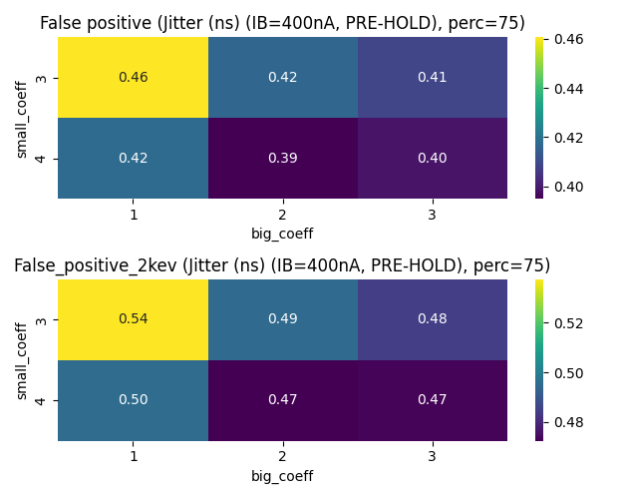
Grouping algorithm, false positives

Slide 10
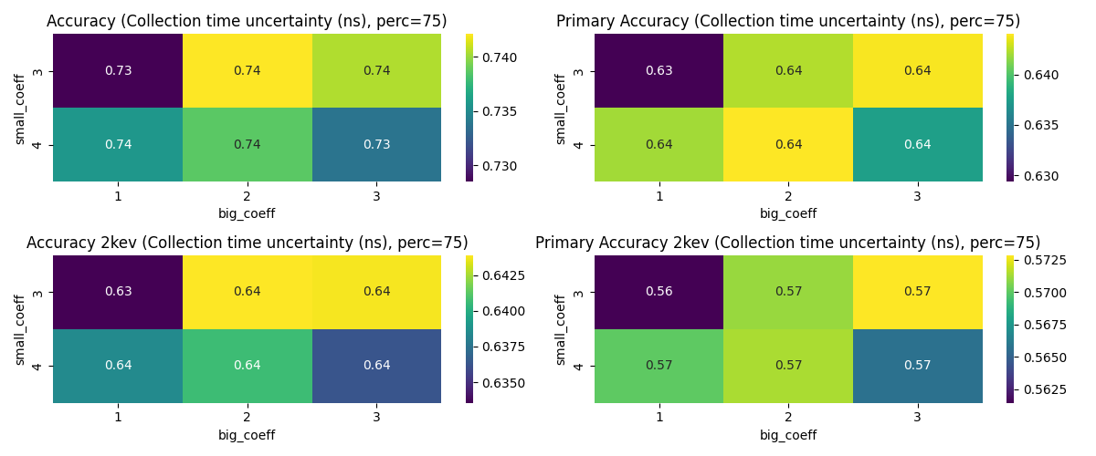
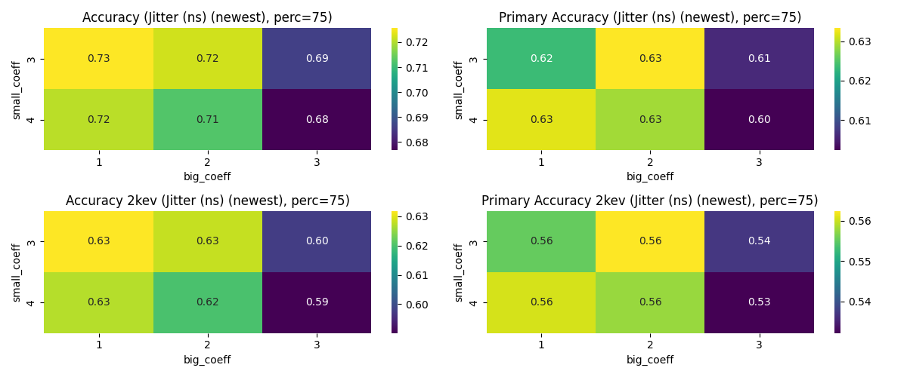
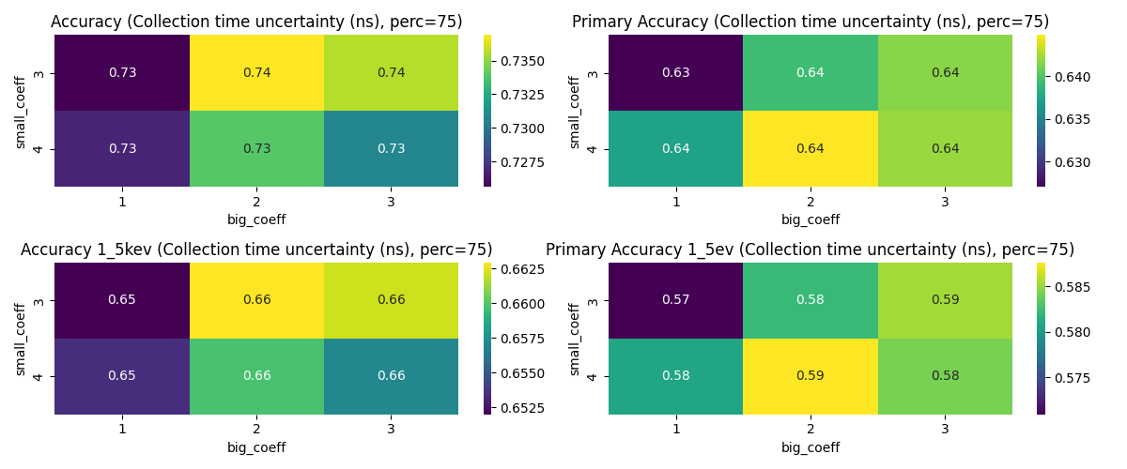
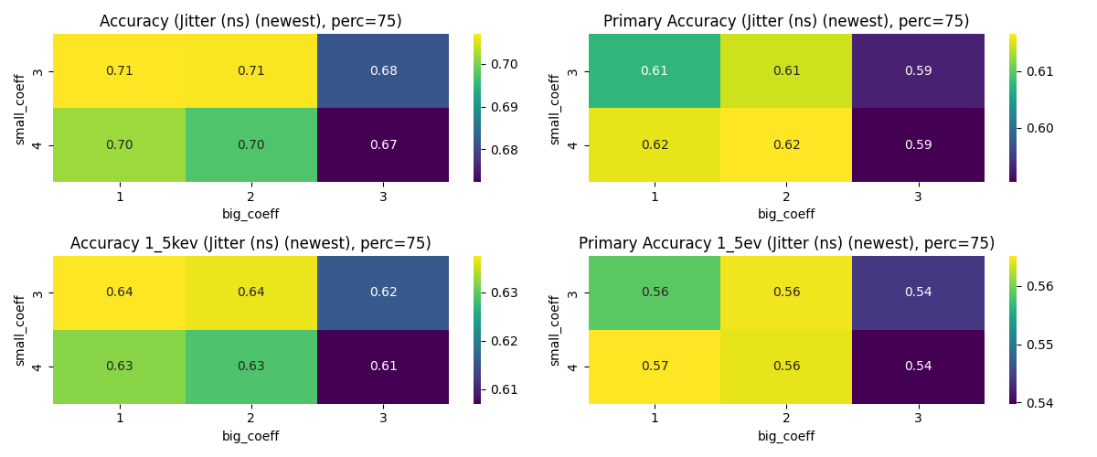
Grouping algorithm
Using radii distributions from only primaries: no big improvement in accuracy due to algorithm better performance at 1 or 2 int lengths, while primaries have usually longer chains than object scattered
Using 1.5 kev threshold instead: no major worsening in accuracy

Slide 11
Grouping algorithm conclusions
To conclude:
For the SPECT case (2+ interactions per event), the accuracy of the algorithm investigated can reach up to around 40% for the primaries
Pre hold 400 nA, and the newest jitter model for primaries lead to the same statistical average in accuracy as the physical limit case (p-value test < 0.05)
Overall the difference between the different models is minimal (as is between the physical limit and the t coll + jitter). This because the jitter models have very high time uncertainty at very low energies! Already at 2 or 3 kev the jitter uncertainty is comparable if not smaller to the collection time one.
Deposited energy (keV) | Energy in pixel (keV) | Jitter (ns) (IB=200nA, PRE-HOLD) | Jitter (ns) (IB=400nA, PRE-HOLD) | Jitter (ns) (newest) | Collection time uncertainty (ns)
0,1 | 0 | 18,81 | 10,42 | 185,81 | 7,36
1,12 | 1,12 | 14,97 | 8,34 | 81,66 | 7,26
2,15 | 2,15 | 11,46 | 6,45 | 10,45 | 7,16
3,17 | 2,94 | 8,74 | 4,98 | 5,56 | 7,07
4,20 | 3,66 | 6,28 | 3,64 | 4,01 | 6,97
5,22 | 4,44 | 4,48 | 2,63 | 2,92 | 6,88
6,24 | 5,26 | 3,46 | 2,01 | 2,29 | 6,78
7,27 | 6,10 | 2,81 | 1,63 | 1,88 | 6,69

Slide 12
Thank you for your attention!
Any questions?
Notes:
Put notes on all slides that could come often in case of questions like specifics on the experiments or things like that and remove this

